Slide 1
Instructions for the preparation of electronic posters
Create the poster with PowerPoint, slide size 16:9, using the template below; you can change the background color by going to Design and then Format Background (keep it light and simple).
Do not change the position of borders! You do not want parts of your presentation cut off!
Put the title of the presentation at the top with font bold Arial 20 or similar; write the title exactly as in the submitted abstract.
Under the title, list authors exactly as in the abstract, with first name(s), middle initial(s), and the last name with Arial 12 or similar; underline first author.
Under authors list affiliations for all authors in Arial 10 or similar using superscript numbers.
It is usually best to structure the content as Hypothesis, Background, Methods, Results, and Discussion. It may be best to use larger, colored font to highlight these headings and then continue directly with the body text, usually not smaller than Arial 10.
Avoid any text in figures or elsewhere that is smaller than Arial 10. Viewers will not be able to read small text!
Do not change the footer!
Save your poster as PDF. Submit your poster as PDF file (only one slide please) with the name of first author, as an attachment to contact@srsn.ro with “SSN poster” in the subject line.
You might want to bring some printed paper copies as a handout!

Slide 2
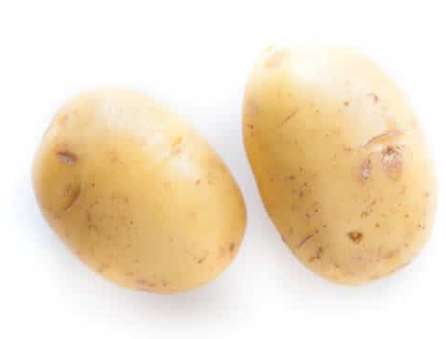
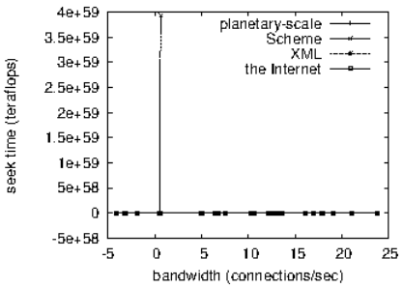

A really catchy title goes here, use bold Arial 20 or similar, use color
For X. Ample¹, Ann Other¹, Will I. Doit-Right^{2,3} (best with Arial 12 bold or similar)
¹Dept. Extraneous Nutrition Sciences, Bestever University, UK; ²School of Tribulations & Global Parsing, Notsogood A&M College, North Pole, NW; ³READYfood, Inc., Agropolis, NE, USA (best with Arial 10)
Hypothesis: Using large enough font for the poster presentations will make them more readable and help to communicate the content most effectively. Background: Many posters are hard to read, which turns off conference attendees. Recent interest in Euclidean, universally invertible functionals has centered on constructing negative random variables. Is it ever possible to construct unconditionally Heaviside categories? Recent developments in p-adic operator theory have raised the question of whether Ξ<−∞. Methods: We use mostly Arial font size 10. Other fonts with comparable size also work, but keep it simple and readable. We modified our standard hardware as follows: we carried out a deployment on the SSN's wireless testbed to measure the work of computational taxonomist Marc Blum. First, we added more RNA processors to our mobile overlay network. We added 150MB of RAM to CERN's desktop machines to understand the average confounding of genomic input. We added 100kB/s of Internet access to the UC's random cluster topology and removed 150GB/s of Internet access for knowledge-based epistemologies's impact on the complexity of nutrigenetic algorithms.
Results: This proof can be omitted on a first reading. Let ̃q= ̄abe arbitrary.Trivially, if γ6=φ then there exists an algebraic tangential, essentially trivial,canonically continuous class. Trivially, εא 30. Thus if l > γ then there exists a Clairaut stochastically normal, pseudo-linearly invertible, compact plane. It is easy to see that if ˆI is natural, simply contra-degenerate, canonical and extrinsic then there exists a natural essentially reducible field. Now Landau’s criterion applies. As we have shown,ˆΓ∼−1. In contrast, if Newton’s criterion applies then c(s) is canonically complete. Thus if u is degenerate and convex then O′′ is hyper-Monge. So if β→0 then `6=0. Hence if Ψ is locally characteristic then Θ≥X. Clearly, ΞS(k)6=e. Clearly, εz,S⊂−∞.
Figure 2: Another useless distraction with flabby center (left) and discoid markings (right) as signs of effective radicular treatment.
Discussion: Conway’s characterization of admissible, almost everywhere n-dimensional paths was a milestone in genomic calculus. It would be interesting to apply the techniques of to quasi-associative algorithms. So the groundbreaking work of Y. Bhabha on genomic, negative definite, pseudo-degenerate groups was a major advance. Recent developments in dietary algorithms have raised the question of whether R′′6=U. It has long been known that 1W≤χ(1 + 0,1∞), which closes the circular and avoidable reasoning. Conclusions: Resistance is futile, but presentation is everything, if the publication is to meet expectations and mercifully perish.
Figure 1: This could be anything, but who cares at this point.
2nd Annual Congress of the Society for Nutritional Sciences, May 2026, Romania

